Slide 1

Employee Data Analysis using Excel
STUDENT NAME: U. JANANEE
REGISTER NO: 422200081
DEPARTMENT: B.COM ISM (Information System Management)
COLLEGE: DRBCCC HINDU COLLEGE
1
Notes:
1

Slide 2

PROJECT TITLE
Demographic and Job Analysis of Employees Using Excel
2

Slide 3



AGENDA
Problem Statement
Project Overview
End Users
Our Solution and Proposition
Dataset Description
Modelling Approach
Results and Discussion
Conclusion
3/21/2024 Annual Review
3

Slide 4

PROBLEM STATEMENT
The analysis of employee demographics and job roles is crucial for organizations to understand their workforce better. However, many organizations struggle with the inconsistent representation of such data. This project aims to develop a structured analysis using Excel to improve the clarity of demographic distributions, job roles, and other key attributes. By creating a system that visually represents these factors, the organization can better assess employee needs, identify trends, and make informed decisions.
4

Slide 5

PROJECT OVERVIEW
This project utilizes the IBM Employee Dataset, which contains comprehensive data about employees, including their age, marital status, education field, job role, business travel frequency, and department. The aim is to leverage Excel to analyze this data and create visualizations such as bar charts and histograms. These visual tools will help HR and management teams understand employee distributions, identify patterns, and take proactive measures to improve job satisfaction and performance​
5

Slide 6

WHO ARE THE END USERS?
Human Resource Managers
Top Management and Executives
Department Heads and Team Leaders
Employees
Business Analysts
6

Slide 7

OUR SOLUTION AND ITS VALUE PROPOSITION
Solution:
The solution involves using Excel to create a comprehensive analysis toolkit for visualizing employee demographic and job-related data. By leveraging Excel’s functionalities such as pivot tables, charts, and histograms, the project offers a clear view of the company’s workforce composition and the factors affecting employee engagement and performance.
This solution enables organizations to have a more in-depth understanding of their workforce. The visual clarity provided by Excel ensures data-driven decisions that can improve workforce management, employee satisfaction, and overall organizational efficiency
Value Proposition:
7

Slide 8
Dataset Description
Dataset: Edunet Foundation Dashboard
Features: 34
Features used: 6
Count of Marital Status: text
Count of Education Field: text
Count of Business Travel: text
Count of Job Role: text
Histogram of Age: numbers
Count of Department: text

Slide 9

THE "WOW" IN OUR SOLUTION
Our solution uses Excel’s advanced tools to turn complex employee data into clear, actionable insights. With dynamic charts and pivot tables, management can easily identify trends and make data-driven decisions. It enhances workforce analysis for recruitment, retention, and employee engagement. The intuitive design ensures accurate and visually appealing presentations.
3/21/2024 Annual Review
9

Slide 10
MODELLING
Data Cleaning
Data Transformation
Chart and Diagram Types:
Bar Charts
Column Charts
Stacked Bar Char
Grouped Bar Charts
Validation and Refinement:
Accuracy Check
Feedback Integration
Customization Features
Tool Selection
10

Slide 11
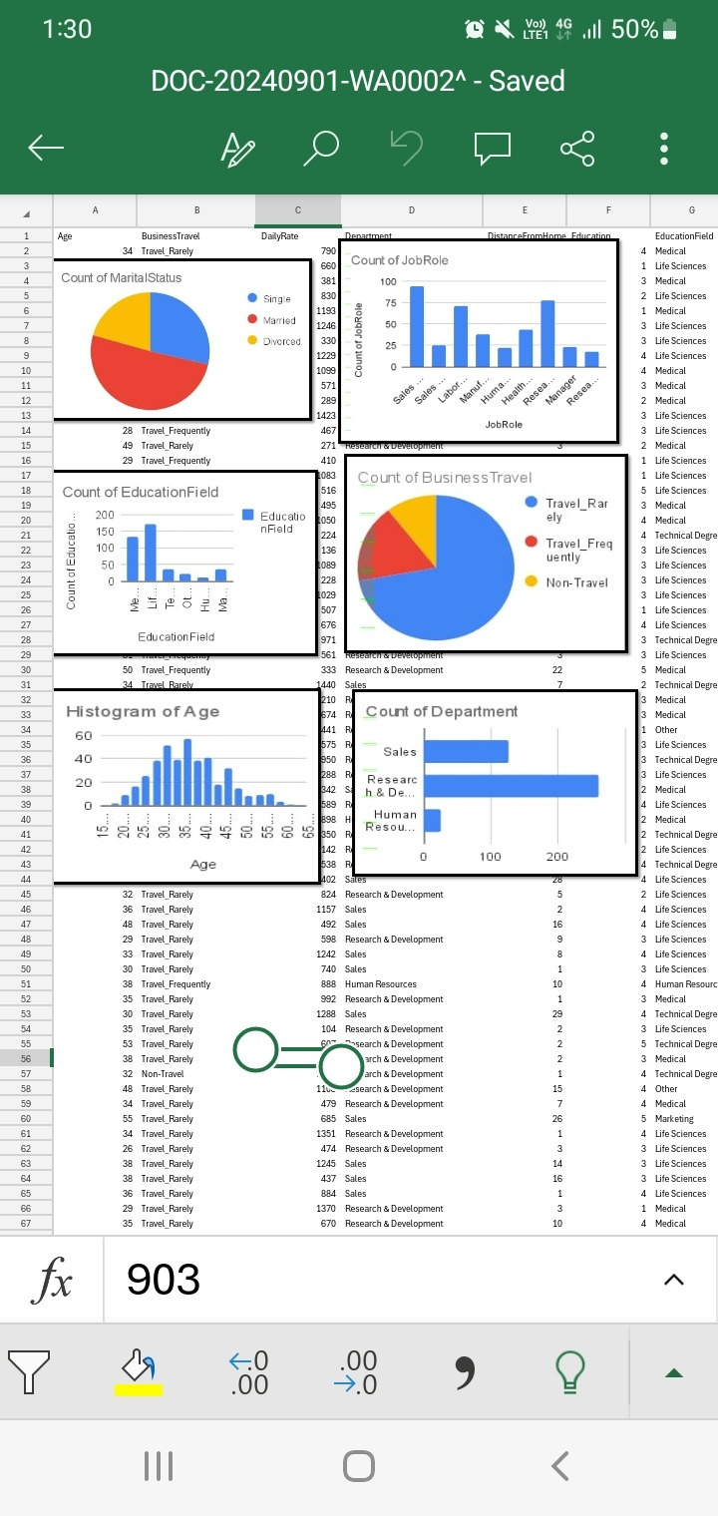
RESULTS
11

Slide 12
conclusion
This project demonstrates Excel’s effectiveness in analyzing employee demographics and job roles. By applying Excel’s data cleaning, transformation, and visualization tools, organizations can uncover key insights into their workforce. These insights enable HR teams to enhance recruitment, retention, and training strategies. Ultimately, this fosters a more engaged and productive workforce. Excel’s user-friendly interface ensures that complex data is presented clearly and effectively.

